Slide 1


Key Success Factors of Digital Transformation
Vision and Mission
Strategy
KRAs and KPIs
Process Workflow
Business Process Cycle
Instinctual Connect
Measurement
Change Management
Digital Technology
ICT
Moore’s Law
Internet
Data Communication
SMAC
IoT
Software
Tools
Digital Strategy and Process
Digital Mindset & Skills
Disruptive Innovation
Non-disruptive Innvn
Common techniques
Cross-Pollination
Intersection & Fusion
Dare-To-Try
Innovation in DX
Backbone & Empwrmt
Risk-takers
Data-Driven
Customer Obsessed
Tech-savvy
Business-savvy
Agile
Empowered
Adaptable
DIGITAL TRANS-FORMATION
Innovation –Business Models &
Technology
Business Technology Alignment
Cust Interaction stages
Customer Touchpoints
Data Collection
Fm Data to Insights
Fm Insights to Strategy
Customer Life Cycle
Customer centricity
Voice of Customer
Outcome driven
Shared Culture
Strategy alignment
Structure alignment
Process alignment
Drive for Innovation
Aligned Priorities
Tactical alignment
Customer Experience Management
Drive for DATA is embedded in each KSF
© Ashish Pachory

Slide 2
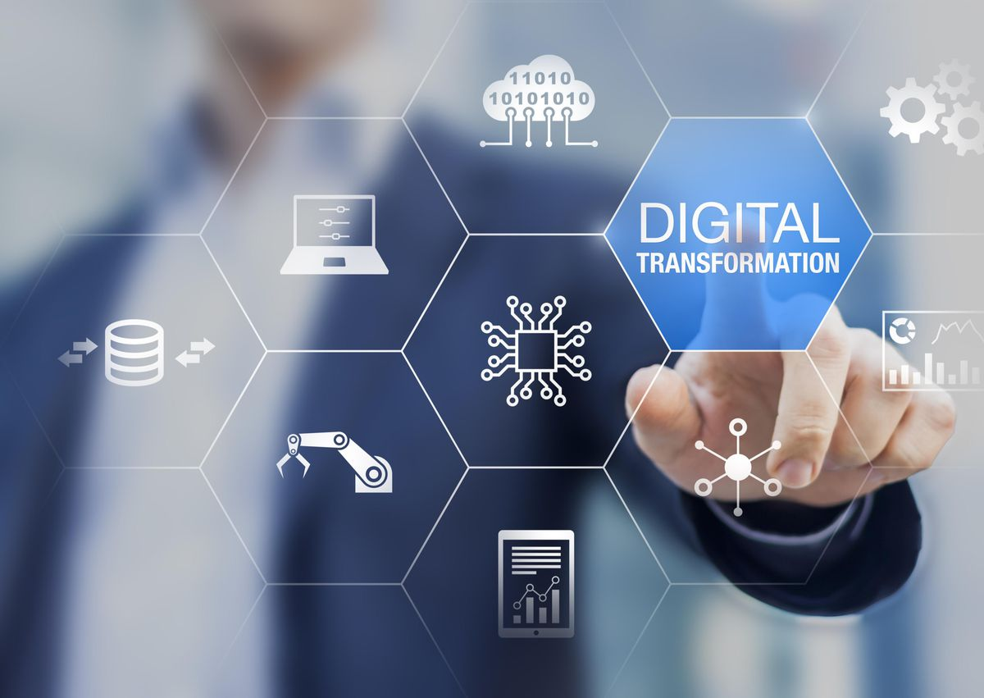
Lecture Series
Disruptive Business Models
apachory@iitgoa.ac.in
Ashish Pachory

Slide 3
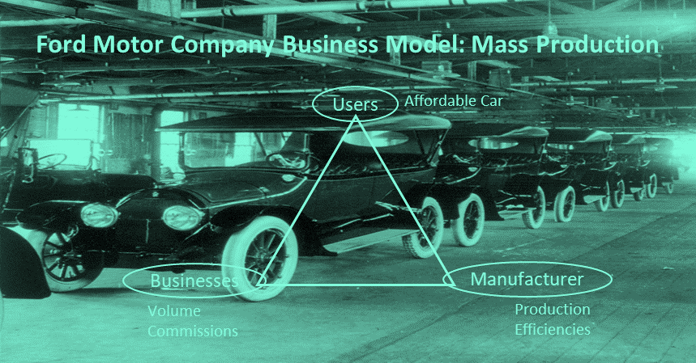
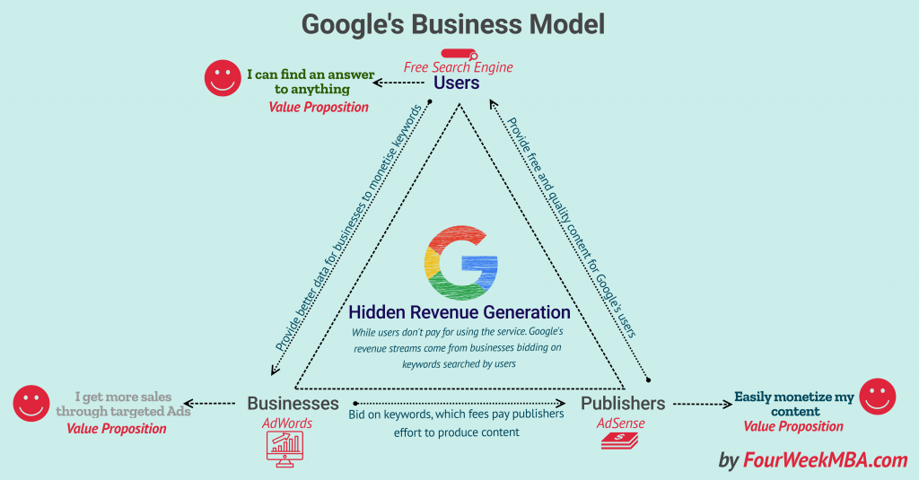
What is a Business Model?
According to Wikipedia:
A business model describes the rationale of how an organization creates, delivers, and captures value, in economic, social, cultural or other contexts. The process of business model construction and modification is also called business model innovation and forms a part of business strategy.

Slide 4

The Internet Business Model
Customer (C2C)
Customer (B2C)
Competitor
Intermediary
Advertising
Manufacturer
Partner
Subscriber
Service
Regulator
Merchant
Community

Slide 5

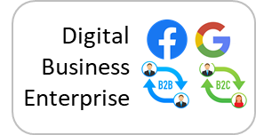

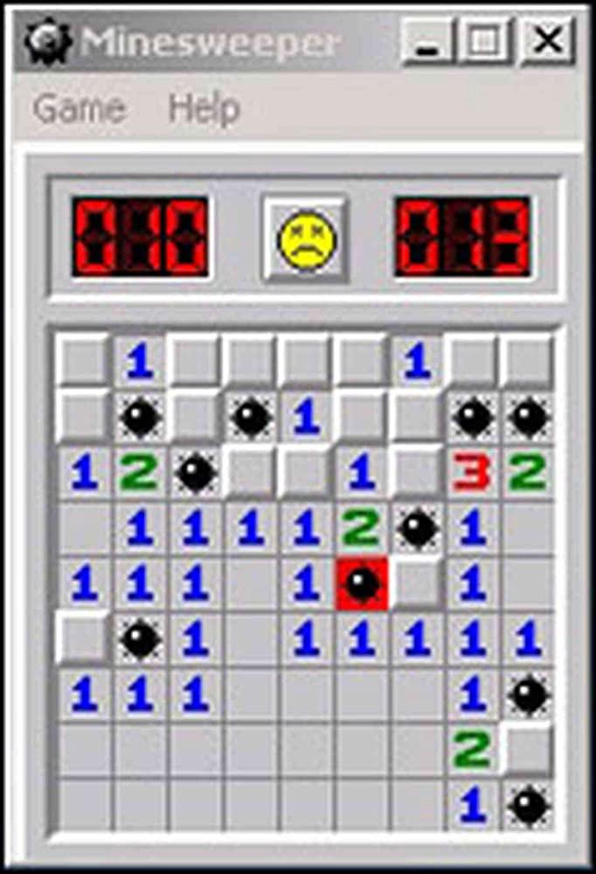





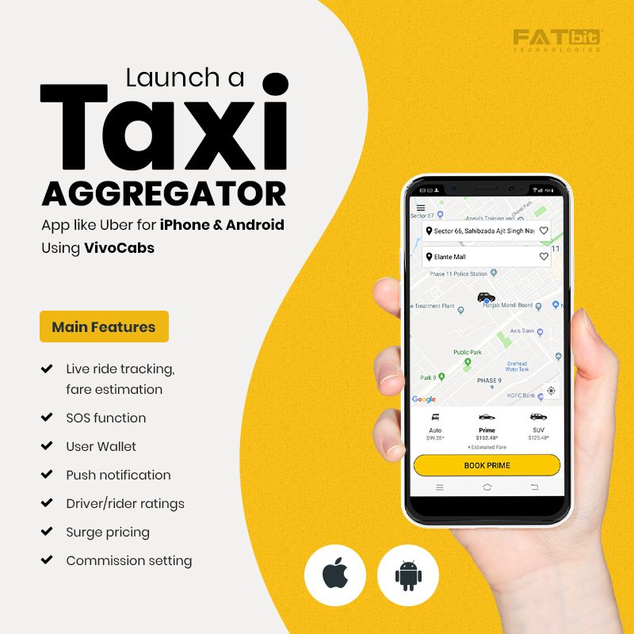
Monetization
Monetization = making money
How does the ad based monetization model work?
Is your digital application just an app or is it a business?
How can you monetize you app? Is there an opportunity?
Money
Ads
Advertisers
Just an app
Ad Impression
Usage Data
Money
Clock
Minesweeper
Notepad
Content
More than an app – A Business
Users
Content Publisher
Netflix
Twitter
Uber / OLA / Lyft

Slide 6
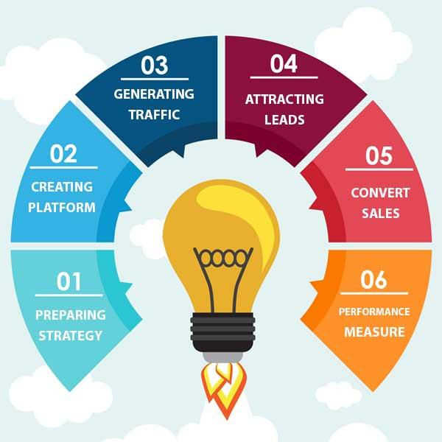
Digital Marketing
Keywords
Blogging
Webinars
LinkedIn
Establish Thought leadership (blogs, news, tips)
Improve CRM
Market Analysis (Data Mining)
Social Media Platform
Interaction Networks
Crowdsourcing platforms
Data harvesting platforms
Market research platform
Online marketing platform
Appealing Landing page design
Quality content on website
Localized SEO strategy
Videos
Personalization
Focus on CLV, churn factors
Website Marketing
Search Engine Optimization
Pay-per-click advertising
Email Marketing
Social Media Marketing
Video Marketing
Overall website traffic
Traffic by Source
Average session duration
Most visited pages
New vs. repeat visitors
Lead conversion rate

Slide 7

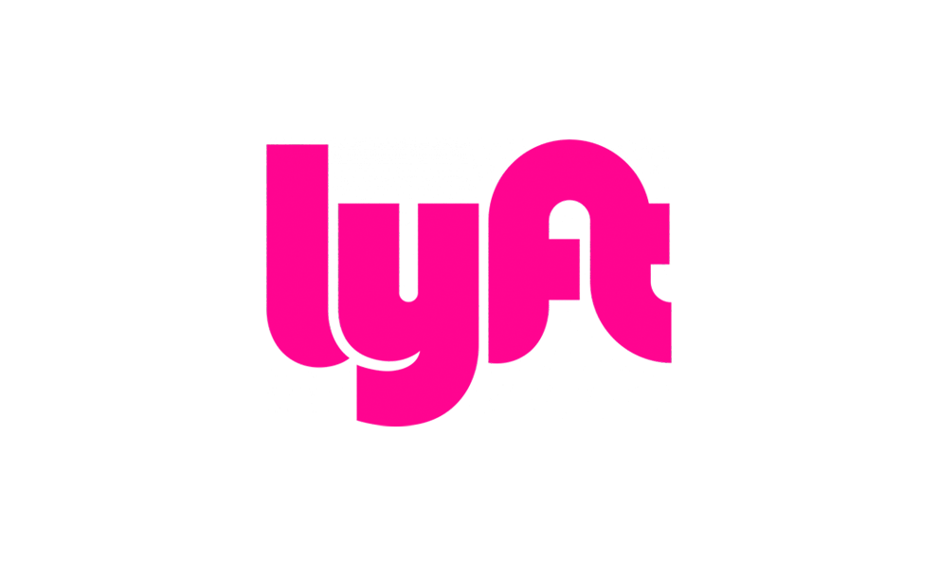
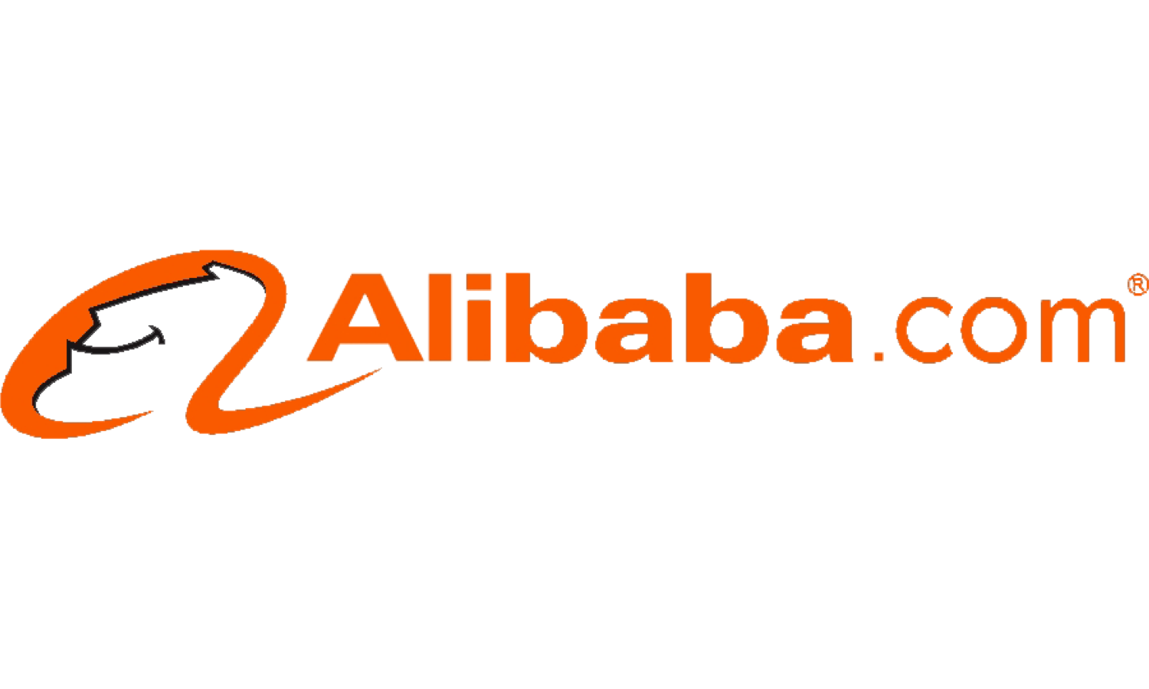







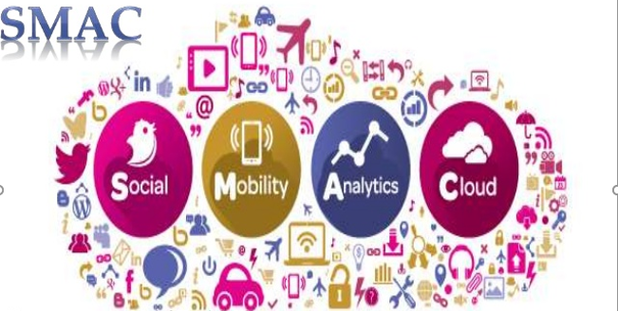






Common Digital Business Models
Shared Economy
Marketplace Model
User Experience Premium
Free Offerings
Pyramid Model
Subscription Model
Ecosystem Model
Freemium Model
On-Demand Model

